Slide 1




Graphs
Fundamentals, Terminology, Traversal, Algorithms
Data Structures and Algorithms
Telerik Software Academy
http://academy.telerik.com

Slide 2

Table of Contents
Graph Definitions and Terminology
Representing Graphs
Graph Traversal Algorithms
Connectivity
Dijkstra’s Algorithm
Topological sorting
Prim and Kruskal

Slide 3
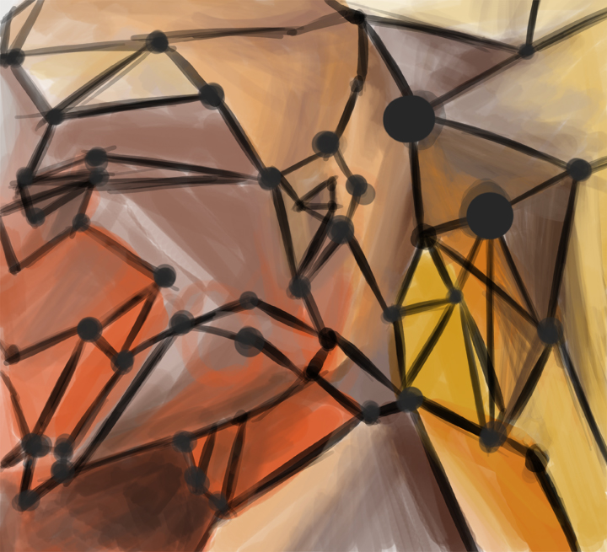
Graphs
Definitions and Terminology

Slide 4
Graph Data Structure
Set of nodes with many-to-many relationship between them is called graph
Each node has multiple predecessors
Each node has multiple successors
Node with multiple successors
Node with multiple predecessors
7
1
14
4
21
11
12
19
31

Slide 5
Graph Definitions
Node (vertex)
Element of graph
Can have name or value
Keeps a list of adjacent nodes
Edge
Connection between two nodes
Can be directed / undirected
Can be weighted / unweighted
Can have name / value
Node
A
Edge
A
B

Slide 6
Graph Definitions (2)
Directed graph
Edges have direction
Undirected graph
Undirected edges
22
2
3
A
F
7
J
1
4
D
G
21
12
E
C
H
19
3

Slide 7
Graph Definitions (3)
Weighted graph
Weight (cost) is associated with each edge
10
A
F
4
5
N
J
6
16
8
Q
D
7
22
G
9
3
14
K
E
C
H

Slide 8
Graph Definitions (4)
Path (in undirected graph)
Sequence of nodes n₁, n₂, … n_{k}
Edge exists between each pair of nodes n_{i}, n_{i+1}
Examples:
A, B, C is a path
H, K, C is not a path
B
C
A
G
K
H
N

Slide 9
Graph Definitions (5)
Path (in directed graph)
Sequence of nodes n₁, n₂, … n_{k}
Directed edge exists between each pair of nodes n_{i}, n_{i+1}
Examples:
A, B, C is a path
A, G, K is not a path
B
C
A
G
K
H
N

Slide 10
Graph Definitions (6)
Cycle
Path that ends back at the starting node
Example:
A, B, C, G, A
Simple path
No cycles in path
Acyclic graph
Graph with no cycles
Acyclic undirected graphs are trees
B
C
A
G
K
H
N

Slide 11
Graph Definitions (7)
Two nodes are reachable if
Path exists between them
Connected graph
Every node is reachable from any other node
Unconnected graph with two connected components
Connected graph
A
F
F
J
A
J
D
G
D
G
E
C
H

Slide 12

Graphs and Their Applications
Graphs have many real-world applications
Modeling a computer network like Internet
Routes are simple paths in the network
Modeling a city map
Streets are edges, crossings are vertices
Social networks
People are nodes and their connections are edges
State machines
States are nodes, transitions are edges

Slide 13
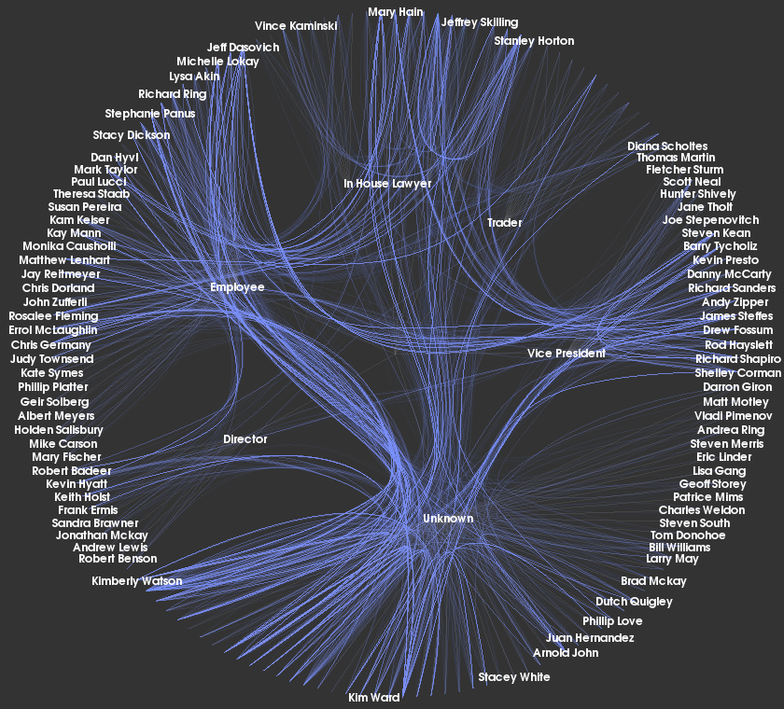
Representing Graphs
Classic and OOP Ways

Slide 14
Representing Graphs
Adjacency list
Each node holds a list of its neighbors
Adjacency matrix
Each cell keeps whether and how two nodes are connected
Set of edges
1 → {2, 4}
2 → {3}
3 → {1}
4 → {2}
3
2
1
4
1
2
3
4
1
0 | 1 | 0 | 1
0 | 0 | 1 | 0
1 | 0 | 0 | 0
0 | 1 | 0 | 0
2
3
4
{1,2} {1,4} {2,3} {3,1} {4,2}

Slide 15
Simple C# Representation
public class Graph
{
List<int>[] childNodes;
public Graph(List<int>[] nodes)
{
this.childNodes = nodes;
}
}
0
6
3
1
4
5
2
Graph g = new Graph(new List<int>[] {
new List<int> {3, 6}, // successors of vertice 0
new List<int> {2, 3, 4, 5, 6},// successors of vertice 1
new List<int> {1, 4, 5}, // successors of vertice 2
new List<int> {0, 1, 5}, // successors of vertice 3
new List<int> {1, 2, 6}, // successors of vertice 4
new List<int> {1, 2, 3}, // successors of vertice 5
new List<int> {0, 1, 4} // successors of vertice 6
});

Slide 16
Advanced C# Representation
Using OOP:
Class Node
Class Connection (Edge)
Class Graph
Optional classes
Using external library:
QuickGraph - http://quickgraph.codeplex.com/

Slide 17
Representing Graphs
Live Demo

Slide 18
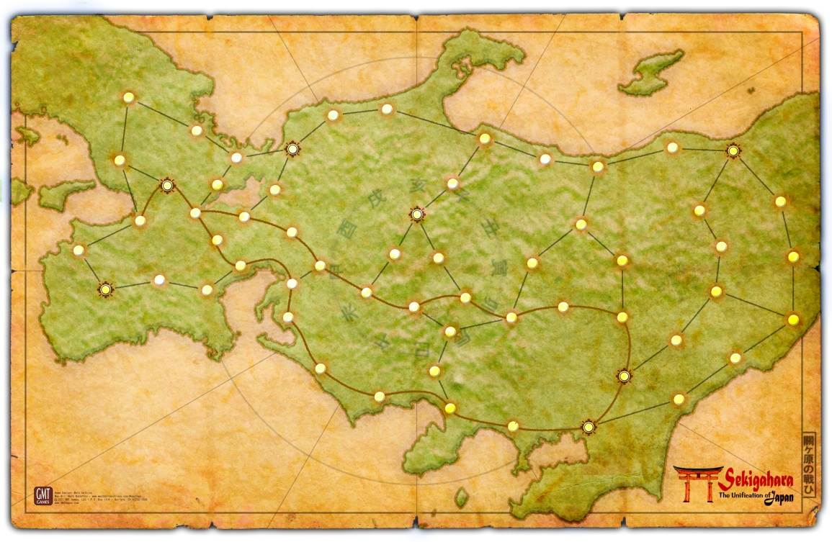
Traversing Graphs
Good old DFS and BFS

Slide 19
Graph Traversal Algorithms
Depth-First Search (DFS) and Breadth-First Search (BFS) can traverse graphs
Each vertex should be visited at most once
BFS(node)
{
queue ← node
visited[node] = true
while queue not empty
v ← queue
print v
for each child c of v
if not visited[c]
queue ← c
visited[c] = true
}
DFS(node)
{
stack ← node
visited[node] = true
while stack not empty
v ← stack
print v
for each child c of v
if not visited[c]
stack ← c
visited[c] = true
}

Slide 20
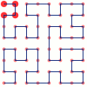
Recursive DFS Graph Traversal
void TraverseDFSRecursive(node)
{
if (not visited[node])
{
visited[node] = true;
print node;
foreach child node c of node
{
TraverseDFSRecursive(c);
}
}
}
vois Main()
{
TraverseDFS(firstNode);
}

Slide 21
Graphs and Traversals
Live Demo

Slide 22

Connectivity
Connecting the chain

Slide 23

Connectivity
Connected component of undirected graph
A sub-graph in which any two nodes are connected to each other by paths

Slide 24
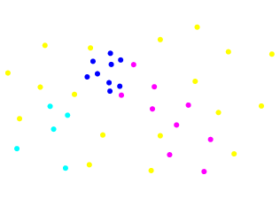
Connectivity (2)
A simple way to find number of connected components
A loop through all nodes and start a DFS or BFS traversing from any unvisited node
Each time you start a new traversing
You find a new connected component!

Slide 25
Connectivity (3)
Algorithm:
foreach node from graph G
{
if node is unvisited
{
DFS(node);
countOfComponents++;
}
}
*Note: Do not forget to mark each node in the DFS as visited!
A
F
C
H
D
G

Slide 26
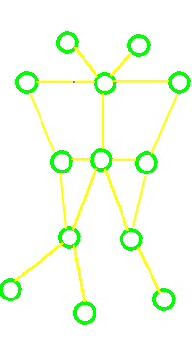
Connectivity (4)
Connected graph
A graph with only one connected component
In every connected graph a path exists between any two nodes
Checking whether a graph is connected
If DFS / BFS passes through all vertices → graph is connected!

Slide 27
Connectivity
Live Demo

Slide 28

Dijkstra’s Algorithm
Shortest path in graph

Slide 29
Dijkstra’s Algorithm
Find the shortest path from vertex A to vertex B - a directed path between them such that no other path has a lower weight.
Assumptions
Edges can be directed or not
Weight does not have to be distance
Weights are positive or zero
Shortest path is not necessary unique
Not all edges need to be reachable

Slide 30
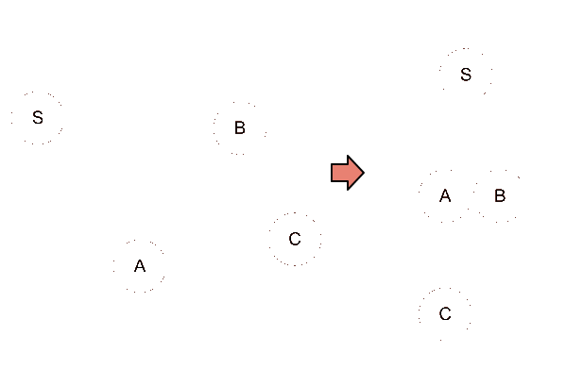
Dijkstra’s Algorithm (2)
In non-weighted graphs or edges with same weight finding shortest path can be done with BFS
*Note: Path from A to B does not matter – triangle inequality

Slide 31
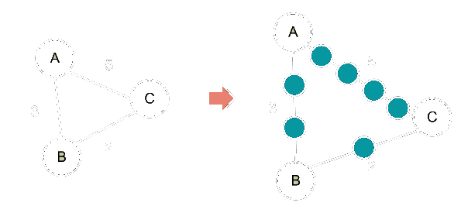
Dijkstra’s Algorithm (3)
In weighted graphs – simple solution can be done with breaking the edges in sub-vertexes
*Too much memory usage even for smaller graphs!

Slide 32
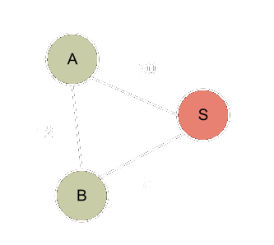
Dijkstra’s Algorithm (4)
Solution to this problem – priority queue instead of queue + keeping information about the shortest distance so far
Steps:
Enqueue all distances from S
Get the lowest in priority - B
If edge B-A exists, check (S-B) + (B-A) and save the lower one
Overcome the triangle inequality miss

Slide 33
Dijkstra’s Algorithm (5)
Dijkstra’s algorithm:
Set the distance to every node to Infinity except the source node – must be zero
Mark every node as unprocessed
Choose the first unprocessed node with smallest non-infinity distance as current. If such does not exist, the algorithm has finished
At first we set the current node our Source

Slide 34
Dijkstra’s Algorithm (6)
Dijkstra’s algorithm:
Calculate the distance for all unprocessed neighbors by adding the current distance to the already calculated one
If the new distance is smaller than the previous one – set the new value
Mark the current node as processed
Repeat step 3.

Slide 35
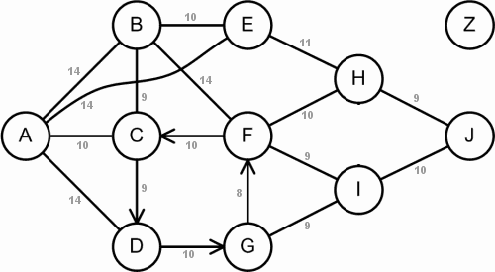
Dijkstra’s Algorithm (7)
Example graph:

Slide 36
Dijkstra’s Algorithm (8)
Pseudo code
set all nodes DIST = INFINITY;
set current node the source and distance = 0;
Q -> all nodes from graph, ordered by distance;
while (Q is not empty)
{
a = dequeue the smallest element (first in PriorityQueue);
if (distance of a == INFINITY) break;
foreach neighbour v of a
{
potDistance = distance of a + distance of (a-v);
if (potDistance < distance of v)
{
distance of v = potDistance;
reorder Q;
}
}
}

Slide 37
Dijkstra’s Algorithm (9)
Modifications
Saving the route
Having a target node
Array implementation, Queue, Priority Queue
A*
Complexity
O((|V| + |E|).log(|V|))
Applications –GPS, Networks, Air travels, etc.

Slide 38
Dijkstra’s Algorithm
Live Demo

Slide 39
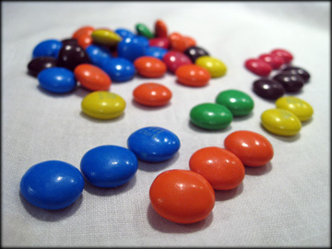
Topological Sorting
Order it!

Slide 40
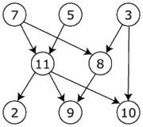
Topological Sorting
Topological ordering of a directed graph
linear ordering of its vertices
for every directed edge from vertex u to vertex v, u comes before v in the ordering
Example:
7, 5, 3, 11, 8, 2, 9, 10
3, 5, 7, 8, 11, 2, 9, 10
5, 7, 3, 8, 11, 10, 9, 2

Slide 41
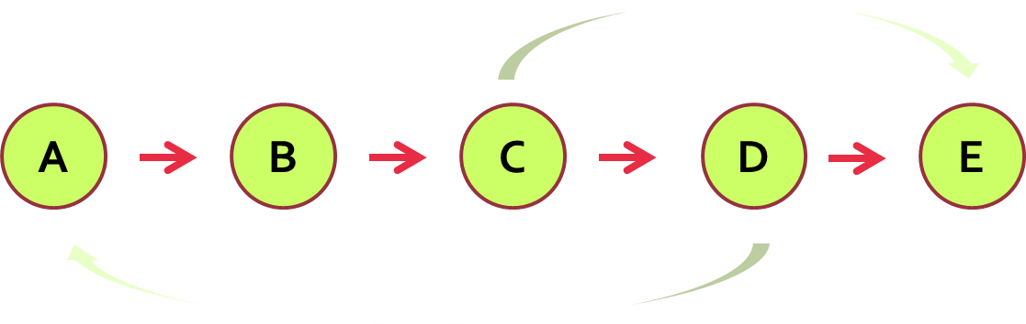
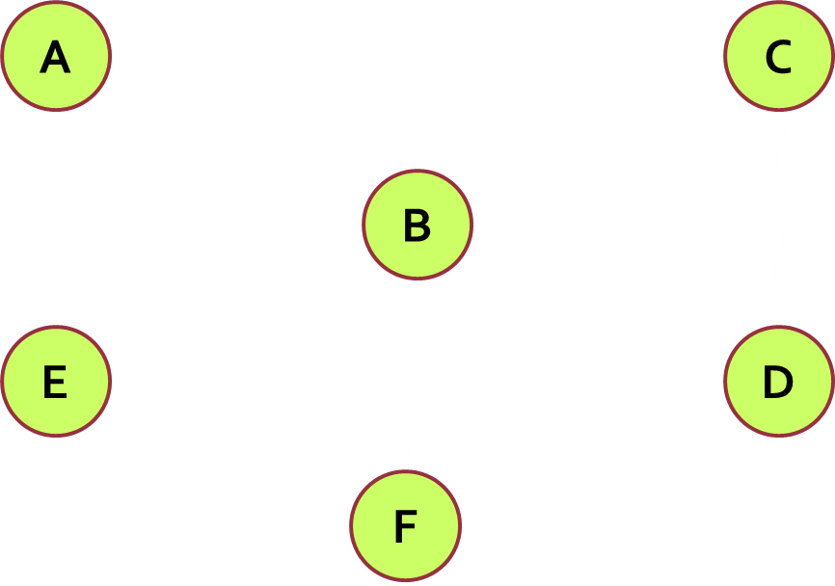
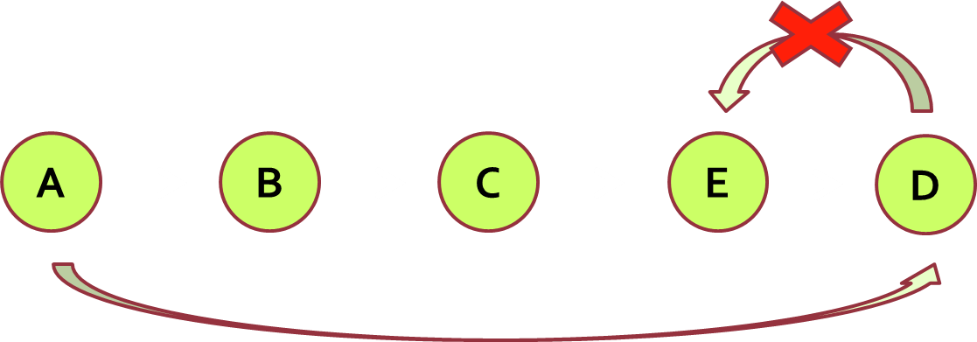
Topological Sorting (2)
Rules
Undirected graph cannot be sorted
Directed graphs with cycles cannot be sorted
Sorting is not unique
Various sorting algorithms exists and they give different results

Slide 42
Topological Sorting (3)
Source removal algorithm
Create an Empty List
Find a Node without incoming Edges
Add this Node to the end of the List
Remove the Edge from the Graph
Repeat until the Graph is empty

Slide 43
Topological Sorting (4)
Pseudo code
L ← Empty list that will contain the sorted elements
S ← Set of all nodes with no incoming edges
while S is non-empty do
remove a node n from S
insert n into L
for each node m with an edge e from n to m do
remove edge e from the graph
if m has no other incoming edges then
insert m into S
if graph has edges then
return error (graph has at least one cycle)
else
return L (a topologically sorted order)

Slide 44
Step #1-2
A
B
C
D
E
F
The Node A is the only Node without Incoming Edges

Slide 45
Step #3-4
B
C
D
E
F
L
A

Slide 46
Step #2-3
B
C
D
E
F
L
A

Slide 47
Step #2-3
C
D
E
F
L
A
B

Slide 48
Step #2-3
C
D
E
F
L
A
B

Slide 49
Step #2-3
D
E
F
L
A
B
C

Slide 50
Step #2-3
D
E
F
L
A
B
C

Slide 51
Step #2-3
E
F
L
A
B
C
D

Slide 52
Step #2-3
E
F
L
A
B
C
D

Slide 53
Result:TS
A
B
C
D
E
F

Slide 54
Topological Sorting (5)
DFS algorithm
Create an empty List
Find a Node without Outgoing Edges
Mark the Node as visited
Add the node to the List
Stop when reach visited node
Reverse the List and get the TS of the Elements

Slide 55
Topological Sorting (6)
Pseudo code
http://www.geeksforgeeks.org/topological-sorting/
L ← Empty list that will contain the sorted nodes
while there are unmarked nodes do
select an unmarked node n
visit(n)
function visit(node n)
if n has a temporary mark then stop (not a DAG)
if n is not marked (i.e. has not been visited yet) then
mark n temporarily
for each node m with an edge from n to m do
visit(m)
mark n permanently
add n to head of L

Slide 56
TS Using DFS
Live Demo

Slide 57
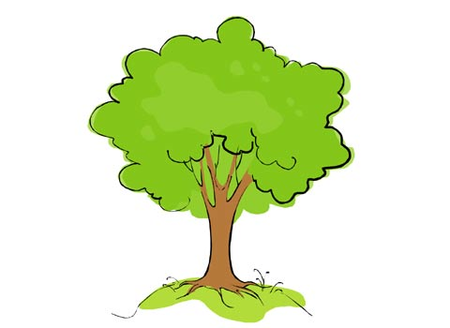
Minimum Spanning Tree

Slide 58
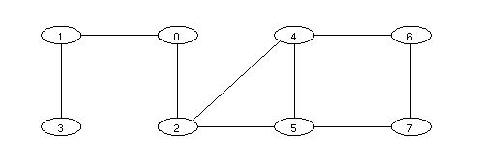
Minimum Spanning Tree
Spanning Tree
Subgraph (Tree)
Connects all vertices together
All connected graphs have spanning tree

Slide 59

Minimum Spanning Tree
Minimum Spanning Tree
weight <=
weight(all other spanning trees)
First used in electrical network
Minimal cost of wiring

Slide 60
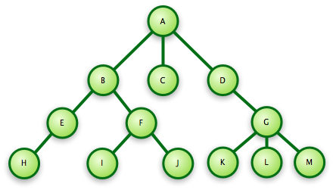
Minimum Spanning Forest

Slide 61
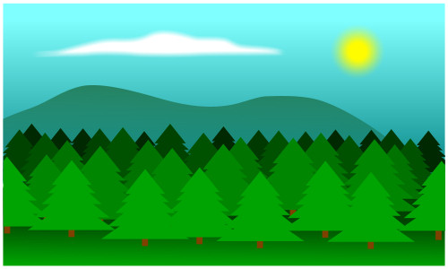
Minimum Spanning Forest
Minimum Spanning Forest – set of all minimum spanning trees (when the graph is not connected)

Slide 62
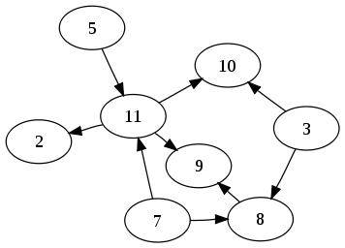
Prim’s Algorithm

Slide 63
Prim’s Algorithm
Create a tree T containing a single vertex (chosen randomly)
Create a set S from all the edges in the graph
Loop until every edge in the set connects two vertices in the tree
Remove from the set an edge with minimum weight that connects a vertex in the tree with a vertex not in the tree
Add that edge to the tree
Note: the graph must be connected

Slide 64
Prim’s Algorithm
Note: at every step before adding an edge to the tree we check if it makes a cycle in the tree or if it is already in the queue
When we add a vertex we check if it is the last which is not visited
A
5
C
7
E
9
8
4
20
12
2
F
B
D

Slide 65
Prim’s Algorithm
We build a tree with the single vertex A
Priority queue which contains all edges that connect A with the other nodes (AB, AC, AD)
A
5
C
7
E
9
8
4
20
12
2
F
B
D

Slide 66
Prim’s Algorithm
The tree still contains the only vertex A
We dequeue the first edge from the priority queue (4) and we add the edge and the other vertex (B) form that edge to the tree
We push all edges that connect B with other nodes in the queue
Note that the edges 5
and 9 are still
in the queue
A
5
C
7
E
9
8
4
20
12
2
F
B
D

Slide 67
Prim’s Algorithm
Now the tree contains vertices A and B and the edge between them
We dequeue the first edge from the priority queue (2) and we add the edge and the other vertex (D) from that edge to the tree
We push all edges that connect D with other nodes in the queue
A
5
C
7
E
9
8
4
20
12
2
F
B
D

Slide 68
Prim’s Algorithm
Now the tree contains vertices A, B and D and the edges (4, 2) between them
We dequeue the first edge from the priority queue (5) and we add the edge and the other vertex (C) from that edge to the tree
We push all edges that connect C with other nodes in the queue
A
5
C
7
E
9
8
4
20
12
2
F
B
D

Slide 69
Prim’s Algorithm
Now the tree contains vertices A, B, D and C and the edges (4, 2, 5) between them
We dequeue the first edge from the priority queue (7) and we add the edge and the other vertex (E) from that edge to the tree
We push all edges that connect C with other nodes in the queue
A
5
C
7
E
9
8
4
20
12
2
F
B
D

Slide 70
Prim’s Algorithm
Now the tree contains vertices A, B, D, C and E and the edges (4, 2, 5, 7) between them
We dequeue the first edge from the priority queue (8)
A
5
C
7
E
9
8
4
20
12
2
F
B
D

Slide 71
Prim’s Algorithm
This edge will cost a cycle
So we get the next one – 9
This edge will also cost a cycle
So we get the next one – 12
We add it to the tree
We add the vertex F to the tree
A
5
C
7
E
9
8
4
20
12
2
F
B
D

Slide 72
Prim
Live Demo

Slide 73

Kruskal’s Algorithm

Slide 74

Kruskal’s Algorithm
The graph may not be connected
If the graph is not connected – minimum spanning forest

Slide 75
Kruskal’s Algorithm
Create forest F (each tree is a vertex)
Set S – all edges in the graph
While S if nonempty and F is not spanning
Remove edge with min cost from S
If that edge connects two different trees – add it to the forest (these two trees are now a single tree)
Else discard the edge
The graph may not be connected

Slide 76
Kruskal’s Algorithm
We build a forest containing all vertices from the graph
We sort all edges
Edges are – 2, 4, 5, 7, 8, 9, 12, 20
A
5
C
7
E
9
8
4
20
12
2
F
B
D

Slide 77
Kruskal’s Algorithm
At every step we select the edge with the smallest weight and remove it from the list with edges
If it connects two different trees from the forest we add it and connect these trees
A
5
C
7
E
9
8
4
20
12
2
F
B
D

Slide 78
Kruskal’s Algorithm
We select the edge 2
This edge connects the vertices B and D (they are in different trees)
We add it
A
5
C
7
E
9
8
4
20
12
2
F
B
D

Slide 79
Kruskal’s Algorithm
We select the edge 4
This edge connects the vertices A and B (they are different trees)
We add it
A
5
C
7
E
9
8
4
20
12
2
F
B
D

Slide 80
Kruskal’s Algorithm
We select the edge 5
This edge connects the vertices A and C (they are different trees)
We add it
A
5
C
7
E
9
8
4
20
12
2
F
B
D

Slide 81
Kruskal’s Algorithm
We select the edge 7
This edge connects the vertices C and E (they are different trees)
We add it
A
5
C
7
E
9
8
4
20
12
2
F
B
D

Slide 82
Kruskal’s Algorithm
We select the edge 8
This edge connects the vertices E and D (they are not different trees)
We don’t add it
A
5
C
7
E
9
8
4
20
12
2
F
B
D

Slide 83
Kruskal’s Algorithm
We select the edge 9
This edge connects the vertices A and D (they are not different trees)
We don’t add it
A
5
C
7
E
9
8
4
20
12
2
F
B
D

Slide 84
Kruskal’s Algorithm
We select the edge 12
This edge connects the vertices E and F (they are not different trees)
We add it
A
5
C
7
E
9
8
4
20
12
2
F
B
D

Slide 85
Kruskal’s Algorithm
We can have a function that checks at every step if all vertices are connected and the tree that we build is spanning
If we have such function we stop
Otherwise we check for the other edges
We just won’t add them to the tree
A
5
C
7
E
9
8
4
20
12
2
F
B
D

Slide 86
Kruskal
Live Demo

Slide 87
Exercises
Solve these problems from BGCoder:
Algo Academy March 2012 – Problem 05 – Friends of Pesho
Algo Academy February 2013 – Problem 04 – Salaries
You are given a cable TV company. The company needs to lay cable to a new neighborhood (for every house). If it is constrained to bury the cable only along certain paths, then there would be a graph representing which points are connected by those paths. But the cost of some of the paths is more expensive because they are longer. If every house is a node and every path from house to house is an edge, find a way to minimize the cost for cables.

Slide 88
Trees and Graphs
?
?
?
?
?
Questions?
?
?
?
?
?
http://algoacademy.telerik.com

